Slide 1
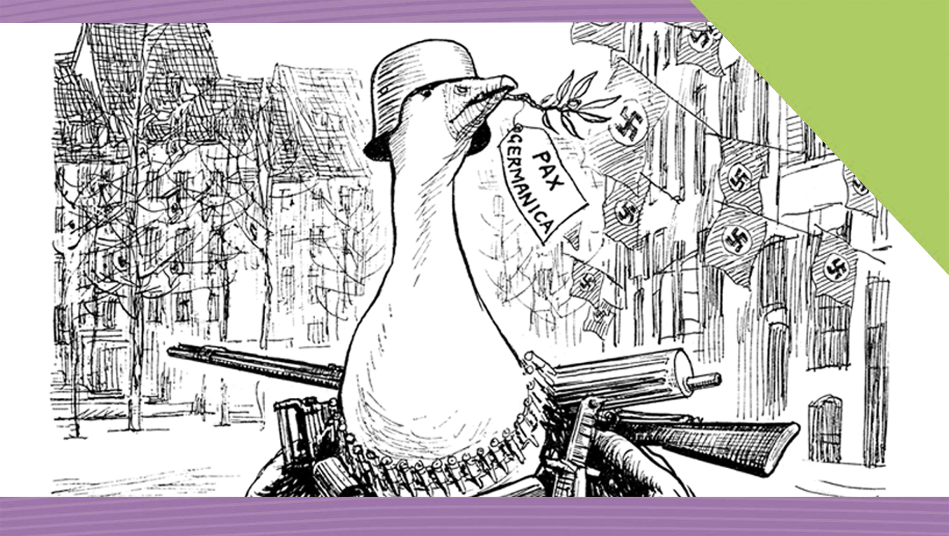
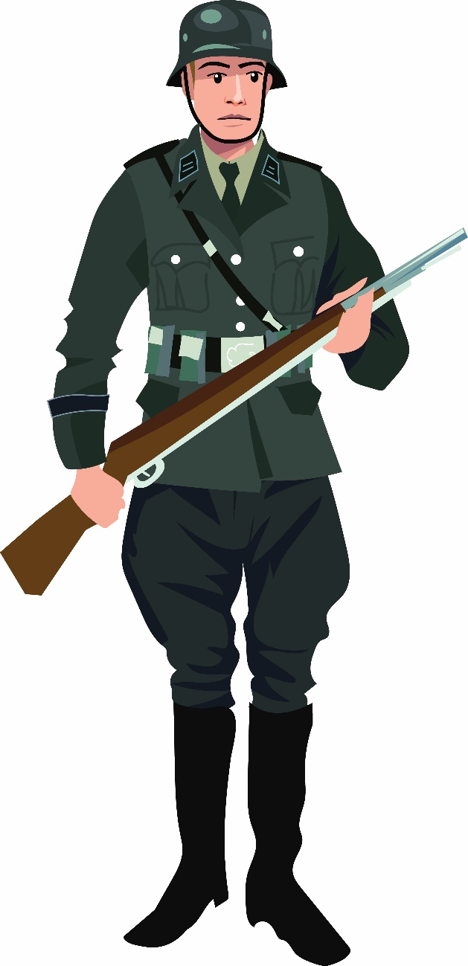

The Drift to War
18
The Causes of World War II
Making History (2nd Edition)

Slide 2
What Will I Learn?
Discuss the causes of World War II
Explore the Nature of History

Slide 3
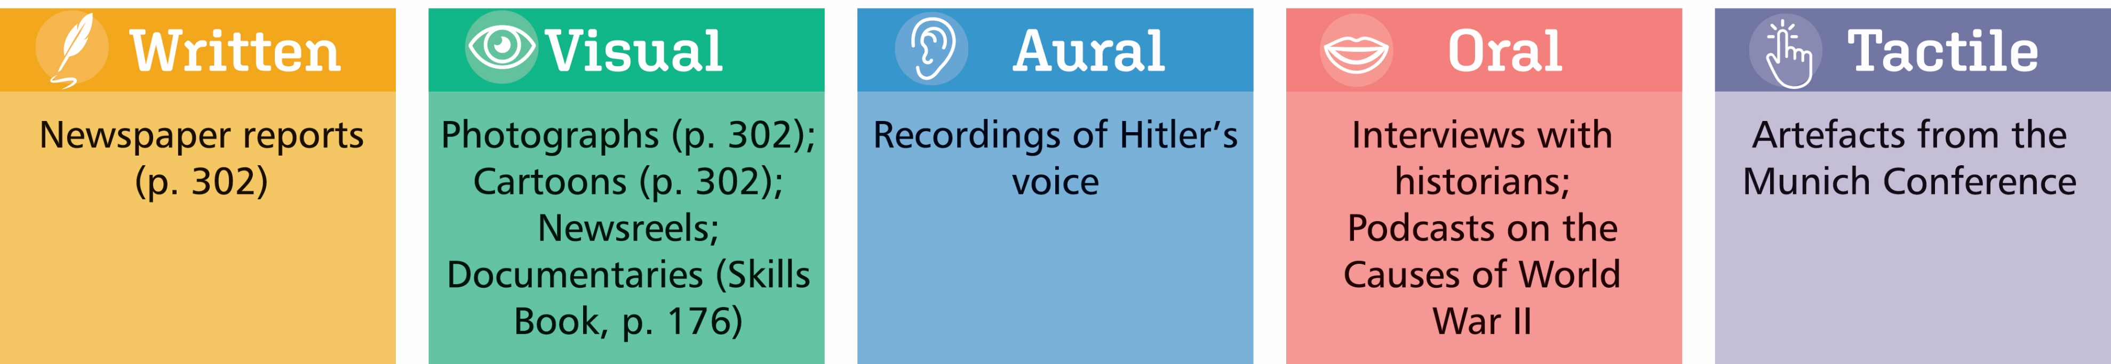
Sources for the Drift to War

Slide 4
Key Words
Appeasement | policy of British government in 1930s which believed that if they gave into Hitler’s small demands then they would prevent a world war
Foreign policy | a policy of country in its dealings with other countries
Cause | an explanation of why events happened
Lebensraum | Nazi policy of living space, to use Eastern Europe and Russia to provide raw materials and workers for the Nazis
Luftwaffe | German air force during the Second World War
Rearmament | building up a new stock of military weapons; increasing numbers in the armed forces
Remilitarisation | moving army back into a country or section of country which had been disarmed

Slide 5
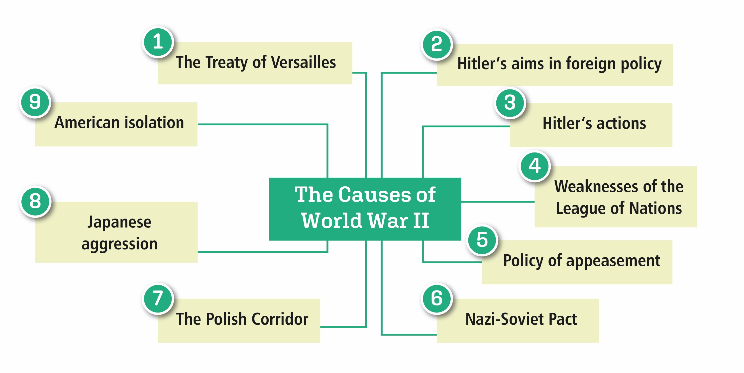
The Causes of World War II

Slide 6
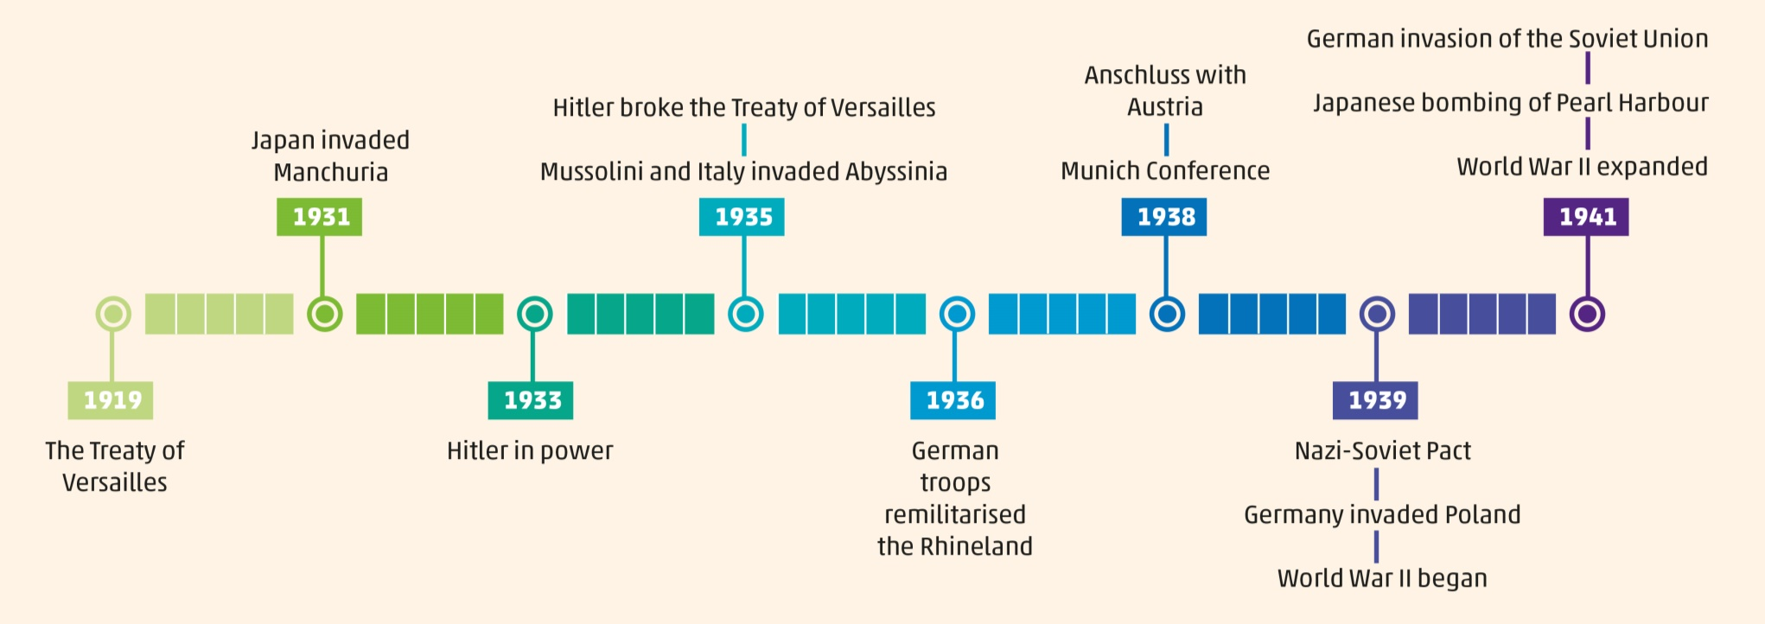
The Causes of World War II
The Drift to War, 1933–41

Slide 7

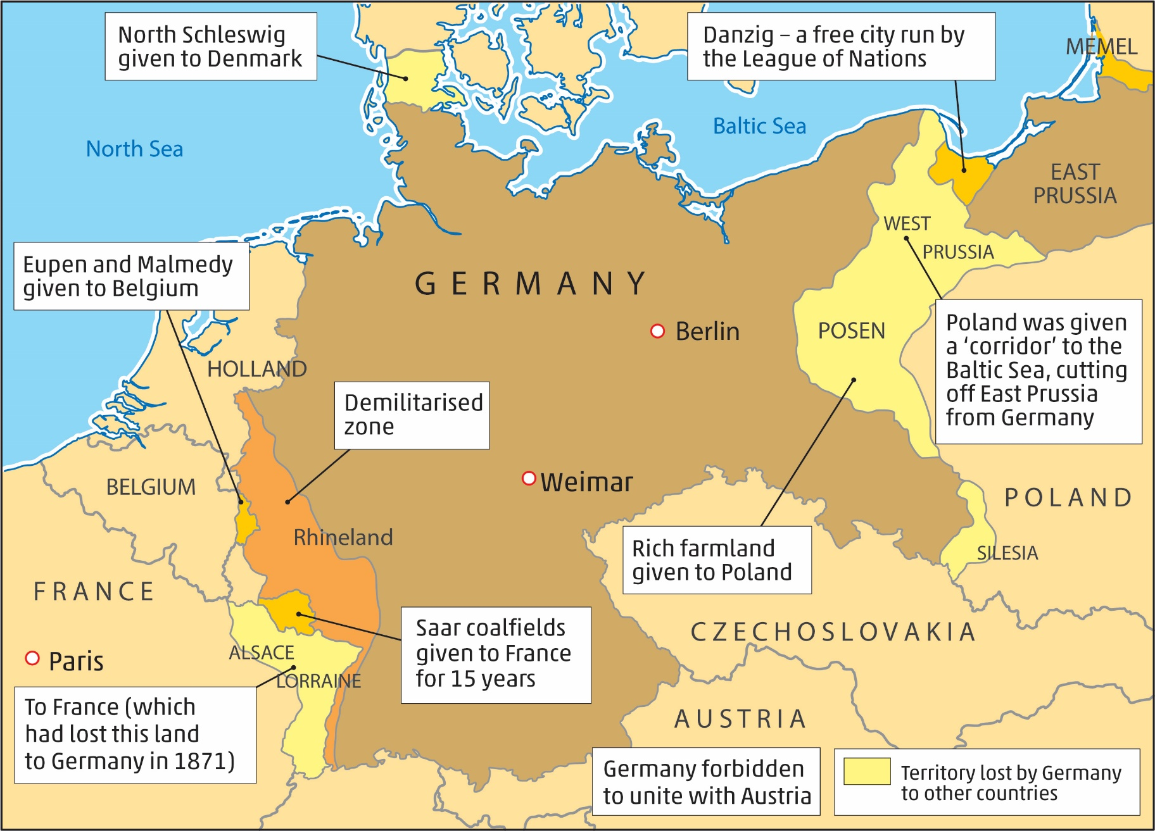
The Treaty of Versailles, 1919
Germany forced to sign the peace treaty at the end of World War I
Terms of the Treaty of Versailles
Germany had to sign ‘war guilt clause’, acknowledging that it caused World War I.
Germany had to pay compensation (reparations) to the Allies.
The German army could not enter the Rhineland (demilitarised).
Part of Germany was cut-off from the main country by the Polish Corridor.
The German armed forces were reduced.
Germany was prevented from uniting with Austria.
Germans resented (disliked) the terms of the Treaty

Slide 8

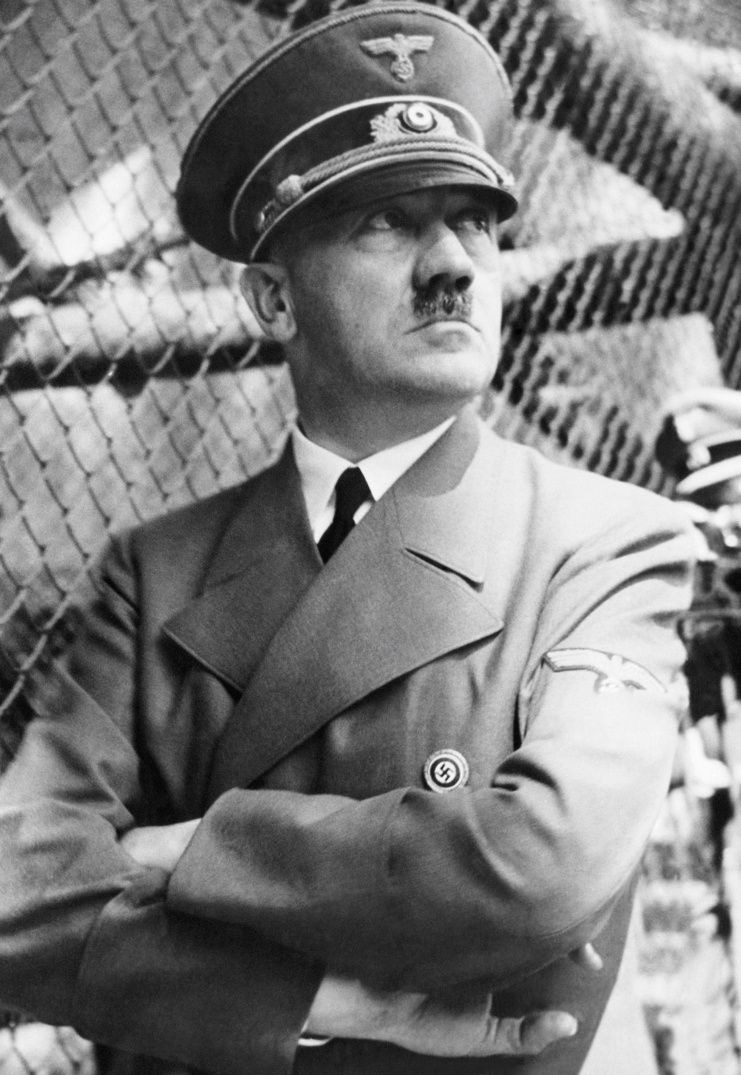
Hitler’s Aims in Foreign Policy
Hitler wanted to make Germany great again
The Nazi Party Programme (1920):
The union of all Germans in a Greater Germany (Grossdeutschland)
The abolition of the Treaty of Versailles
Land for settling surplus population (lebensraum) in Eastern Europe

Slide 9

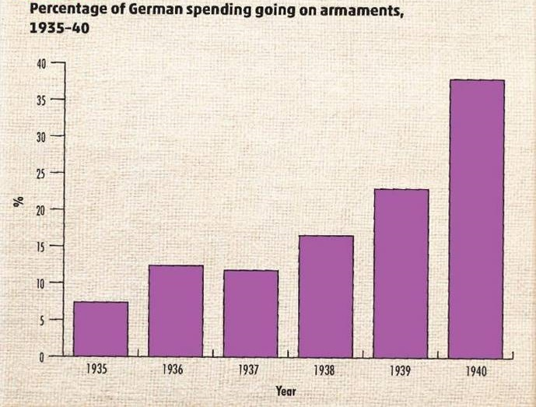
Hitler’s Actions – Destroying the Treaty of Versailles – Rearmament
Army
Navy
Air force (Luftwaffe)
Hitler speaking in a private conversation in 1936
German and Italian rearmament is proceeding more rapidly than rearmament can in England. In three years Germany will be ready.

Slide 10
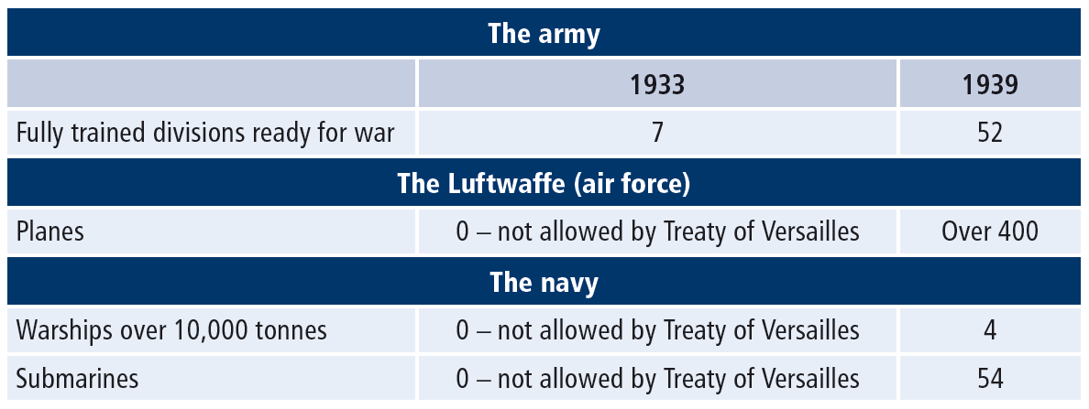
Hitler’s Actions – Destroying the Treaty of Versailles – Rearmament

Slide 11
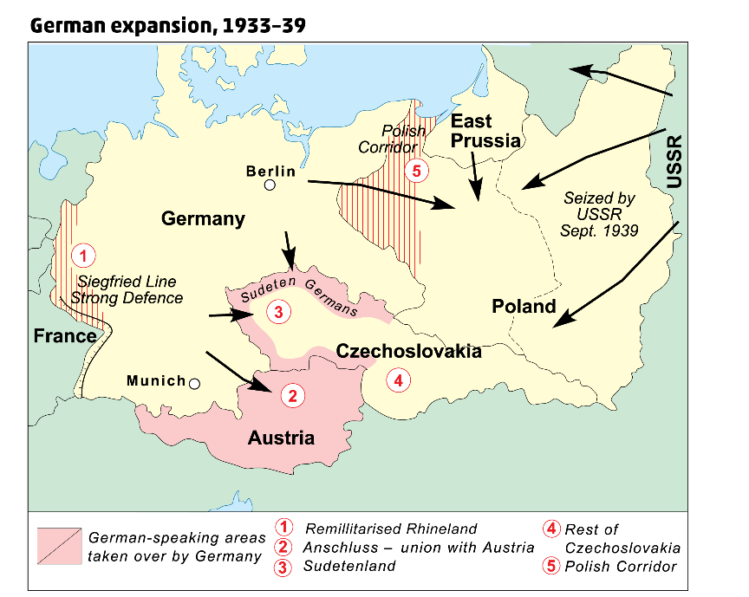
Hitler’s Actions – German Expansion, 1933–39
Remilitarised the Rhineland
Supported Mussolini’s invasion of Abyssinia
Formed Rome-Berlin Axis with Mussolini
United Germany and Austria in Anschluss
Hitler claimed the Sudetenland – German-speaking part of Czechoslovakia
Munich Conference – Chamberlain, Daladier, Mussolini & Hitler
Agreed to force Czechoslovakia to hand over Sudetenland
Hitler took over the rest of Czechoslovakia six months later

Slide 12
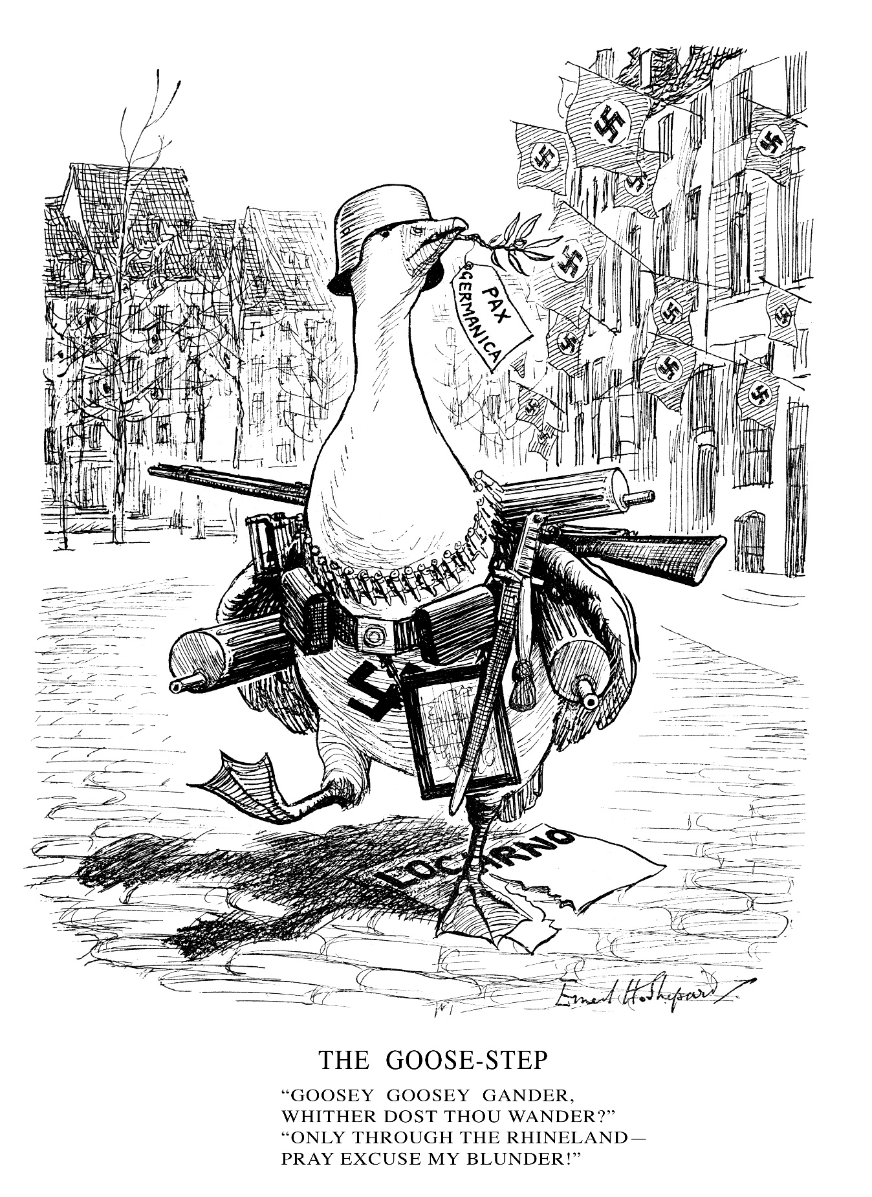

Hitler’s Actions – The Rhineland
What is the message of this cartoon?
Is it pro- or anti-Hitler?
Do you agree that the cartoon is opposed to the remilitarisation of the Rhineland?

Slide 13
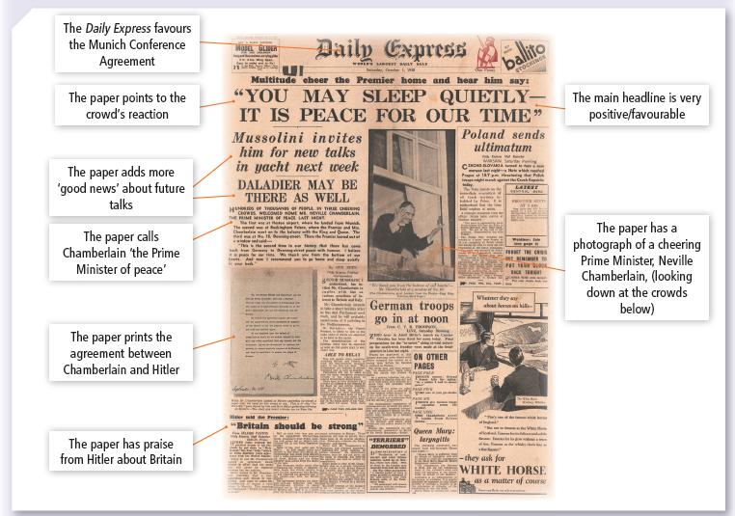

Slide 14
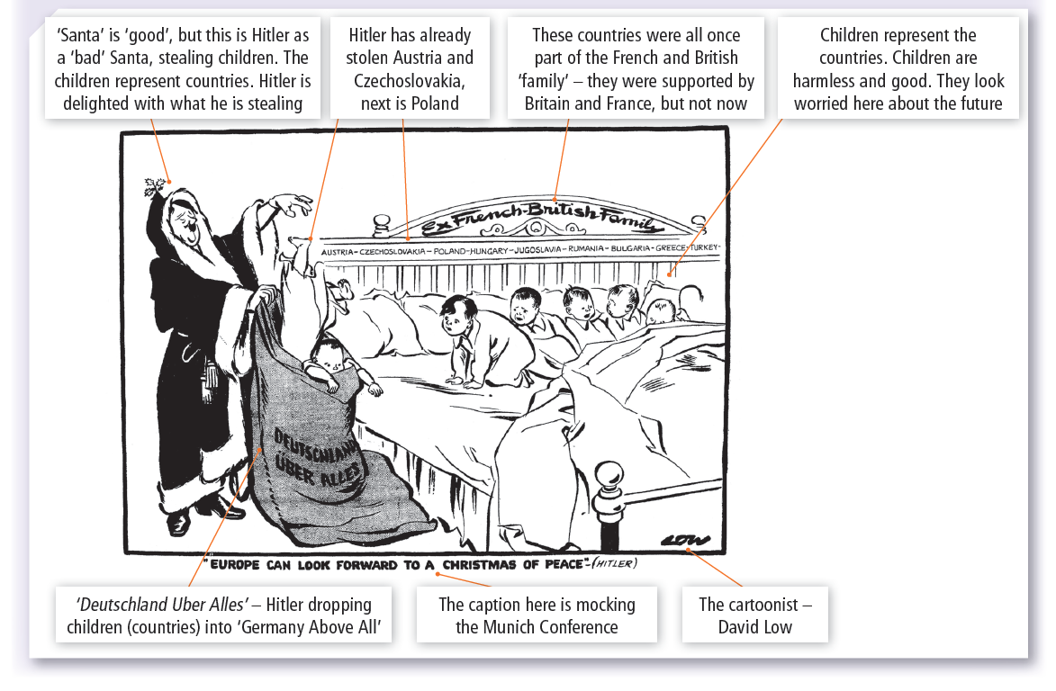

Slide 15

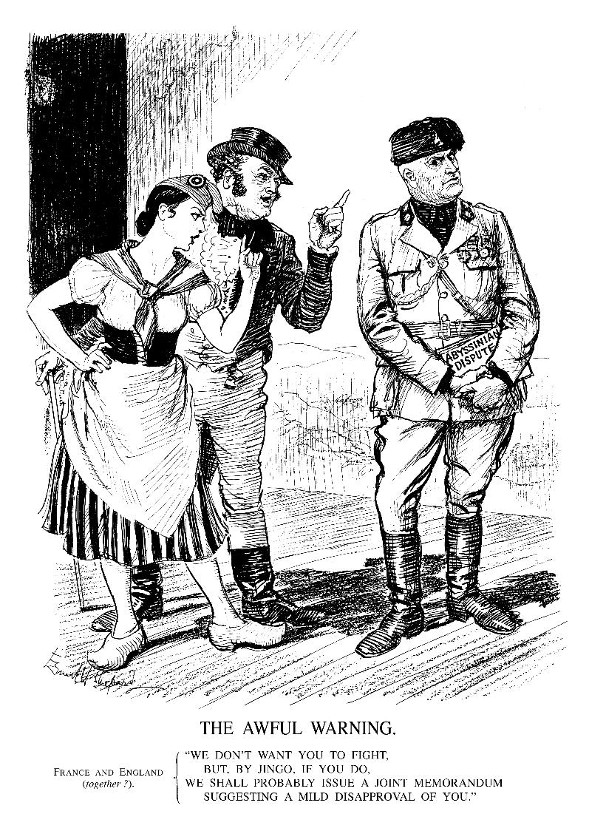
Weakness of the League of Nations
Aims
Promote international co-operation
Achieve international peace
Weaknesses
America did not join
Decisions had to be unanimous
No army; use of economic sanctions
How were the weaknesses of the League of Nations shown up by Mussolini’s invasion of Abyssinia?
The Invasion of Abyssinia, 1935

Slide 16

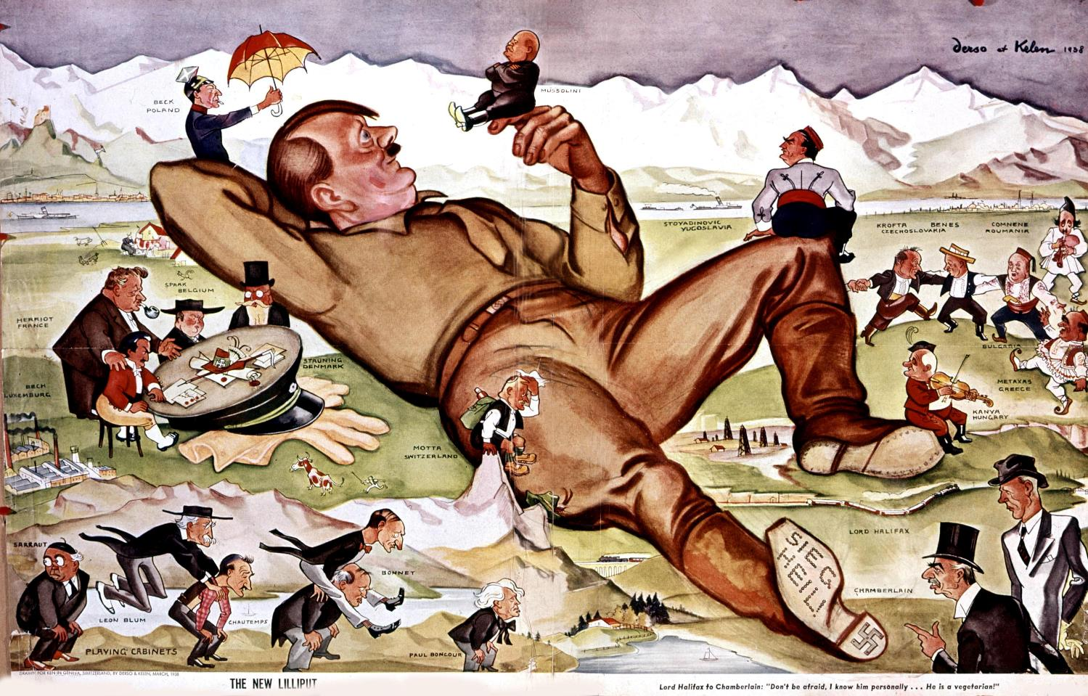
The Policy of Appeasement
When I think of those four terrible years (1914–18) and I think of the seven million men who were cut down in their prime … then I am bound to say in war there are no winners, but all are losers. It is those thoughts that have made me strain every nerve to avoid repetition of the Great War (World War I) in Europe.
(Neville Chamberlain, Prime Minister of Britain, speaking before the Munich Conference, 1938)
Policy of Britain and France
Promoted by Chamberlain, Prime Minister of Britain
Giving into Hitler’s demands will prevent war
Did not want to repeat the horrors of WWI
France built Maginot Line
Hitler saw the policy of appeasement as a sign of weakness
How did the policy of appeasement contribute to causing World War II?

Slide 17

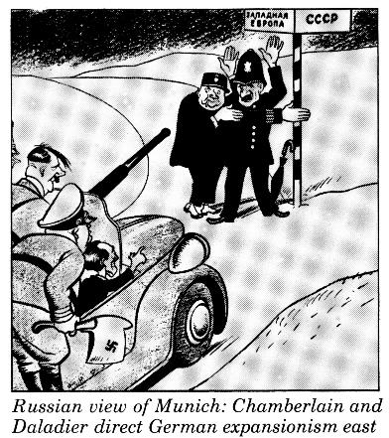
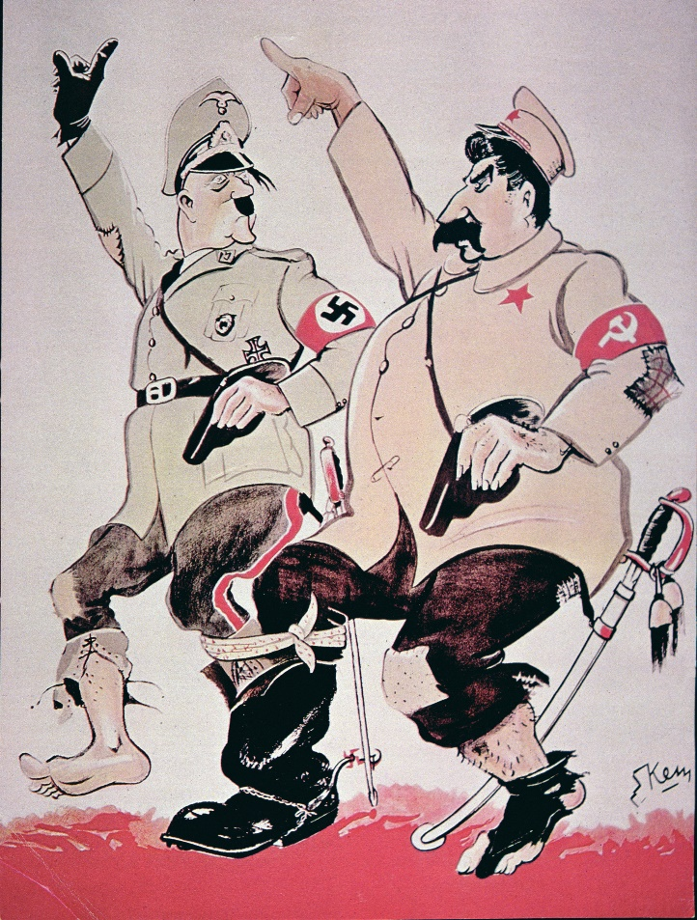
Nazi-Soviet Pact, 1939
Hitler and Stalin, leader of Soviet Union
10-year non-aggression pact
Divide Poland between them
How did the Nazi-Soviet Pact contribute to causing World War II?

Slide 18


The Polish Corridor
Supreme Commander of the Armed Forces Most Secret Directive No. 1 for the Conduct of War
Now that all the political possibilities of disposing by peaceful means of a situation on the Eastern frontier (border), which is intolerable for Germany, are exhausted, I have decided on a solution by force.
Date of attack: 1 September 1939
Time of attack: 4.45 a.m.
Why did Hitler want to control the Polish Corridor?

Slide 19

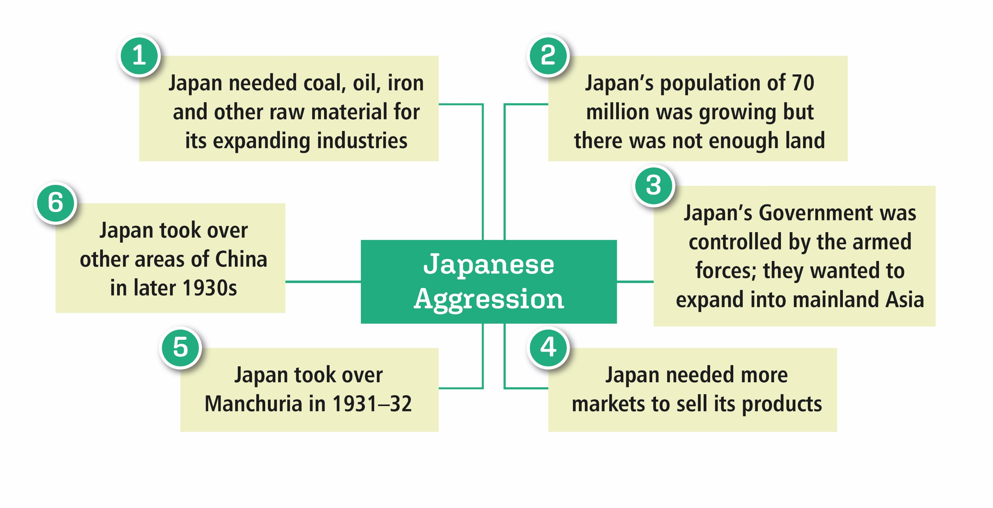
Japanese Aggression in the East
Is it correct to say the Japanese were aggressive in the East?

Slide 20

American Isolation
America did not join the League of Nations
Isolated from world conflicts
Hoped to avoid another war
Forced to take action because of Japanese expansion in Asia
America is a decayed country. …. How can one expect a state like that to hold together – a country where everything is built on the dollar.
(Hitler’s views on America before the war)

Slide 21
The Causes of World War II
The Drift to War, 1933–41
Rest of Czechoslovakia taken over by Germany
Nazi-Soviet Pact
World War II began
German troops remilitarised the Rhineland
Rome-Berlin Axis
Anschluss with Austria Munich Conference
Sudetenland taken by Germany
Germany introduced conscription, broke the Treaty of Versailles
Saar plebiscite
Hitler failed to unite with Austria
Japanese attack on Pearl Harbour
Hitler came to power
1933
1934
1935
1936
1938
1939
1941

Slide 22

Assessing Your Learning
Match the beginning and ending of these sentences:
1. Hitler wanted to create a Greater Germany (Grossdeutschland) … | A. … met at the Munich Conference.
2. Hitler wanted to destroy … | B. … it did not want a repetition of the horrors of WWI.
3. Hitler broke the Treaty of Versailles … | C. … by uniting all German-speaking people.
4. Hitler took a great gamble by … | D. … so they signed the Nazi-Soviet Pact in 1939.
5. The British government followed a policy of appeasement because … | E. … sending German troops to reoccupy (remilitarise) the Rhineland.
6. The United States was not prepared to help Britain or France … | F. ... by introducing conscription and beginning submarine construction.
7. Hitler, Chamberlain, Mussolini and Daladier (France) … | G. … because it followed a policy of isolation.
8. Hitler and Stalin, the leader of the Soviet Union, did not want to fight each other yet, … | H. … … the Treaty of Versailles

Slide 23
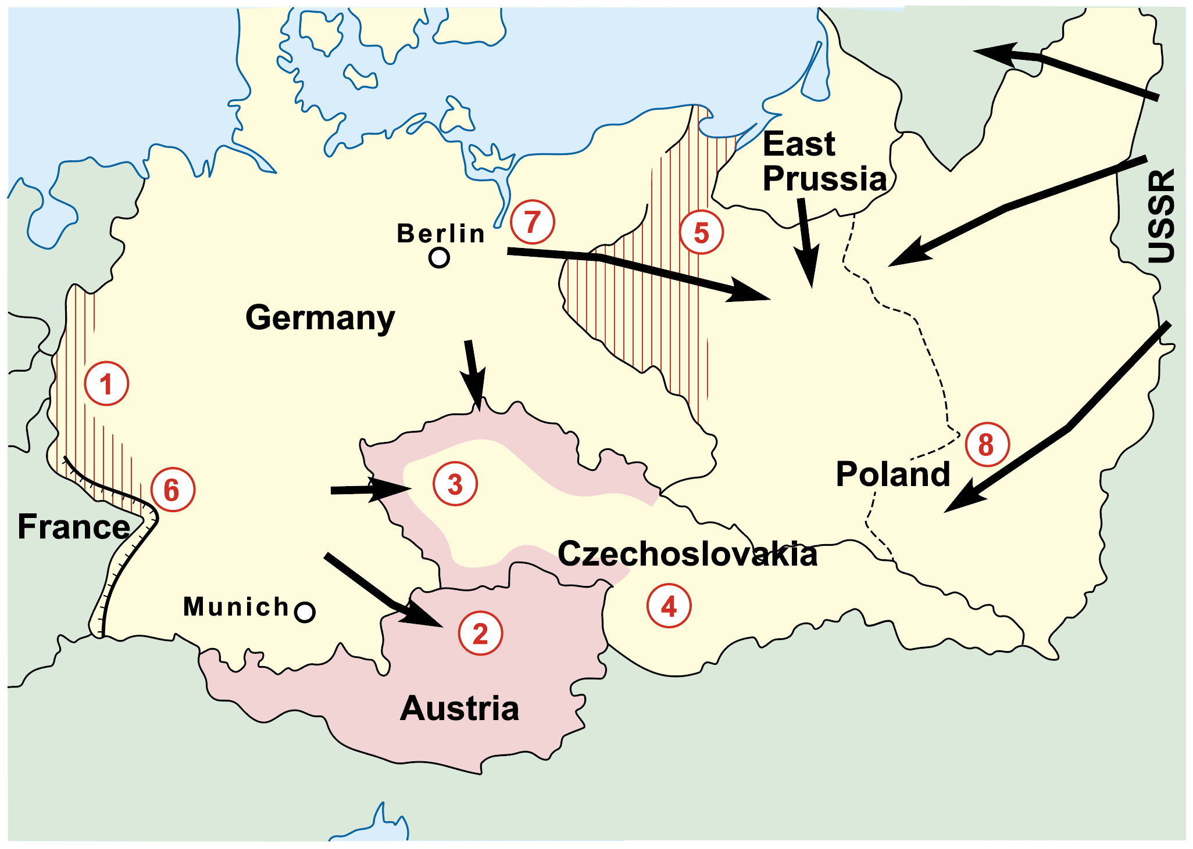
Assessing Your Learning
Identify each of the areas or features numbered 1 to 8:
Areas 1 – 5?
6. What is the name of the line?
7. What does the arrow indicate?
8. What does the arrow indicate?

Slide 24
Assessing Your Learning
Why did the Germans resent (dislike) the terms of the Treaty of Versailles?
How would the achievement of Hitler’s aims in foreign policy cause war?
How did German rearmament break the Treaty of Versailles?
How did German rearmament contribute to causing World War II?
How did the policy of appeasement contribute to causing World War II?
How did the Nazi-Soviet Pact contribute to the causes of World War II?
How did Japanese expansion contribute to the causes of World War II?

Slide 25
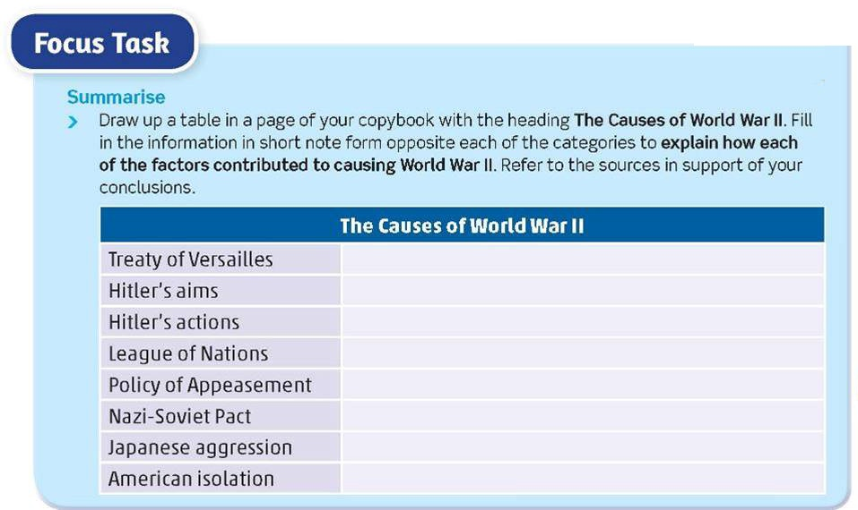
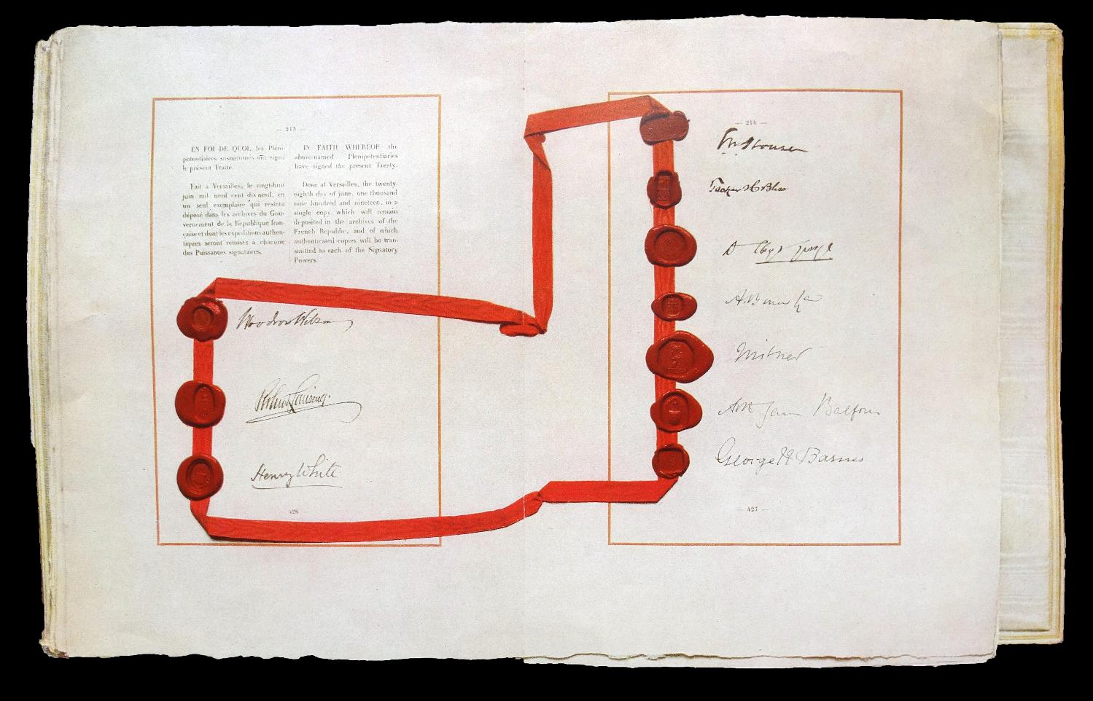

Slide 26
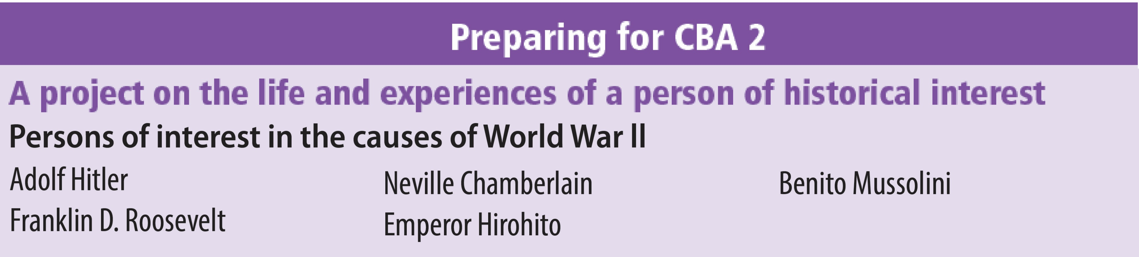
Preparing for CBA 2
**Note your choices**

